Slide 1


DEVOPS- KICKOFF
BHARATH

Slide 2
ABOUT ME
👨‍💻 14+ YEARS OF INDUSTRY EXPERIENCE IN IT INFRASTRUCTURE
& CLOUD
🧑‍🏫 10+ YEARS OF TEACHING: VMWARE, AZURE,AWS CLOUD, AZURE DEVOPS
🎓 TRAINED OVER 2000+ STUDENTS GLOBALLY
💡 PASSIONATE ABOUT SIMPLIFYING COMPLEX TECH
/BHARATH-REDDY329

Slide 3

WHAT THE HELL IS DEVOPS

Slide 4
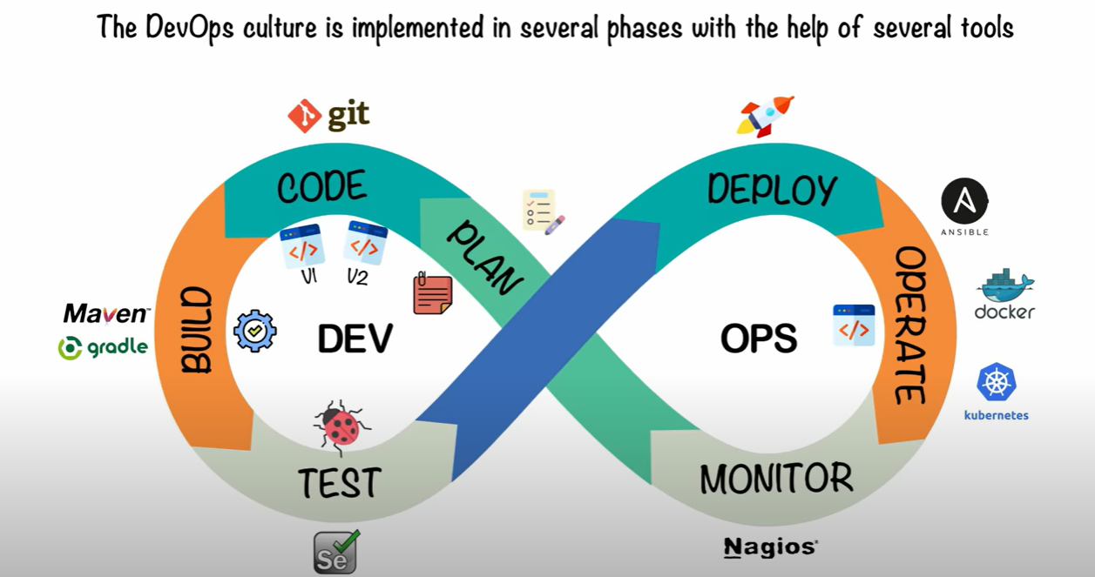

Slide 5


  INTRODUCTION TO CLOUD COMPUTING
  MICROSOFT AZURE and AWS FUNDAMENTALS & ADMIN
  LINUX and Shell scripting
  AZURE CLI
  GIT AND GITHUB/AZURE REPOS
  INTRODUCTION TO DEVOPS
  AZURE DEVOPS/GITHUB ACTIONS/Jenkins
  DOCKER
  KUBERNETES
  MAVEN
  AZURE PIPELINES
  TERRAFORM
  AZURE MONITOR
  Observability with AIOps

Slide 6
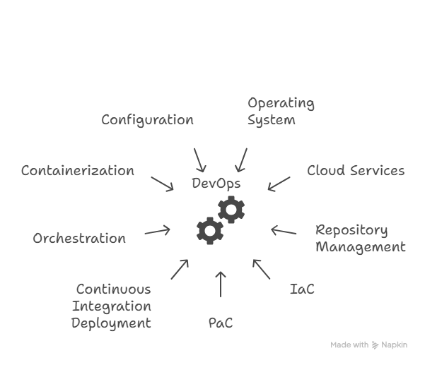

Slide 7
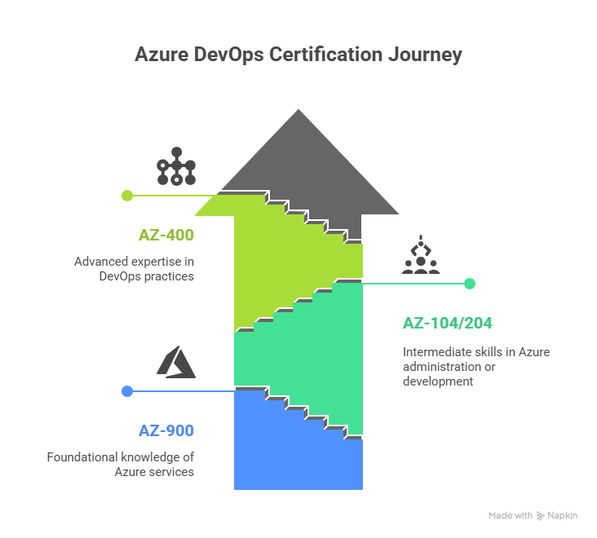

Slide 8
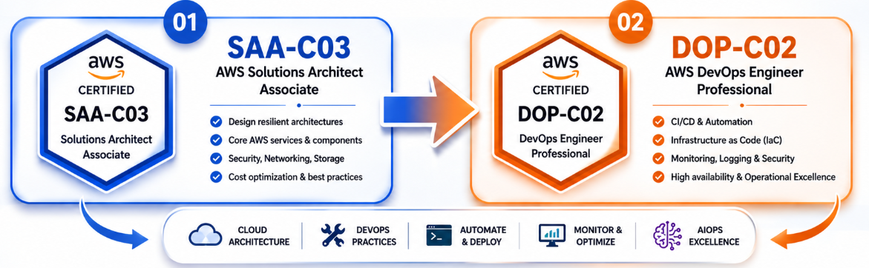
AWS Certification Path

Slide 9

DURATION
100 Sessions

Slide 10
  DURATION: 5 Months
  REAL-LIFE SCENARIOS: YOU WILL SIMULATE ACTUAL PROJECT WORKFLOWS
  RESUME REVIEW + LINKEDIN PROFILE TIPS
  INTERVIEW PREPARATION
  CAREER GUIDANCE
  1:1 INTERACTION

Slide 11
WHO CAN LEARN

Slide 12
  👶 FRESHERS: START STRONG IN A FUTURE-PROOF IT PATH
  👨‍💼 EXPERIENCED PROFESSIONALS: UPGRADE OR SWITCH TO DEVOPS ROLES
  👩‍👦 CAREER BREAK? RE-ENTER IT WITH A STRONG, MODERN SKILLSET
  🎯 IDEAL FOR SYSTEM ADMINS, DEVELOPERS, TESTERS, SUPPORT ENGINEERS, OR CLOUD LEARNERS

Slide 13
WHAT IS DIFFERENT

Slide 14
  🔥 NARRATION WITH REAL LIFE EXAMPLES
  🧠PRACTICAL-FIRST APPROACH, NOT JUST THEORY
  🎥 CLASS RECORDINGS, NOTES, DOUBT SESSIONS
  ✅ REGULAR UPDATES BASED ON LIVE INDUSTRY TRENDS

Slide 15
ANY DOUBTS!!!!!!!

